Slide 1
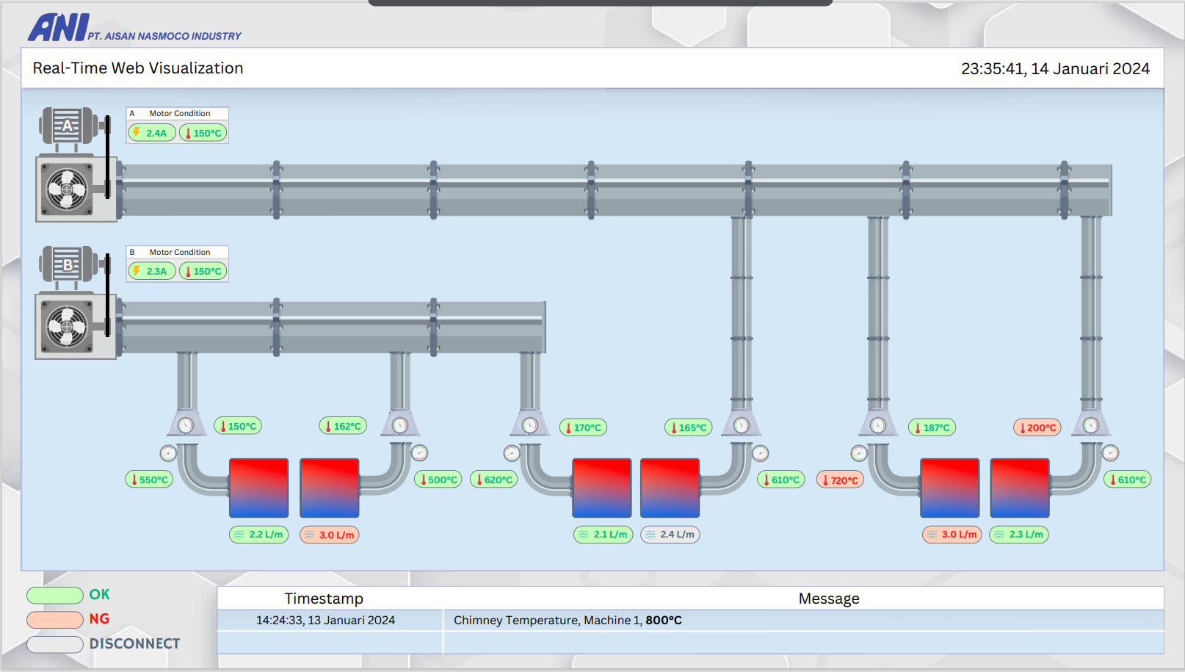
Annealing Process Monitoring

Slide 2

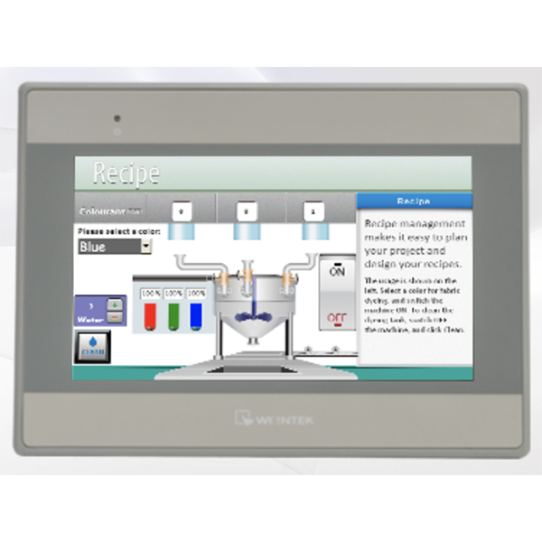


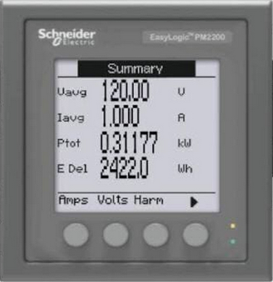









TOPOLOGY
Monitor
Monitor
Monitor
TX4S-B4C
PM2230
HMI
PLC
Mini PC
Mini PC
Mini PC
Server
Panel
RS485
Ethernet
Thermocouple
Flow Meter
Analog to RS485
WP3084

Slide 3
DATA FLOW
Analog
RS485
Ethernet
PM2230
x 2 Pcs
PLC
Server
TX4S-B4C
x 14 Pcs
Flow Meter
Analog to RS485
x 6 Pcs

Slide 4
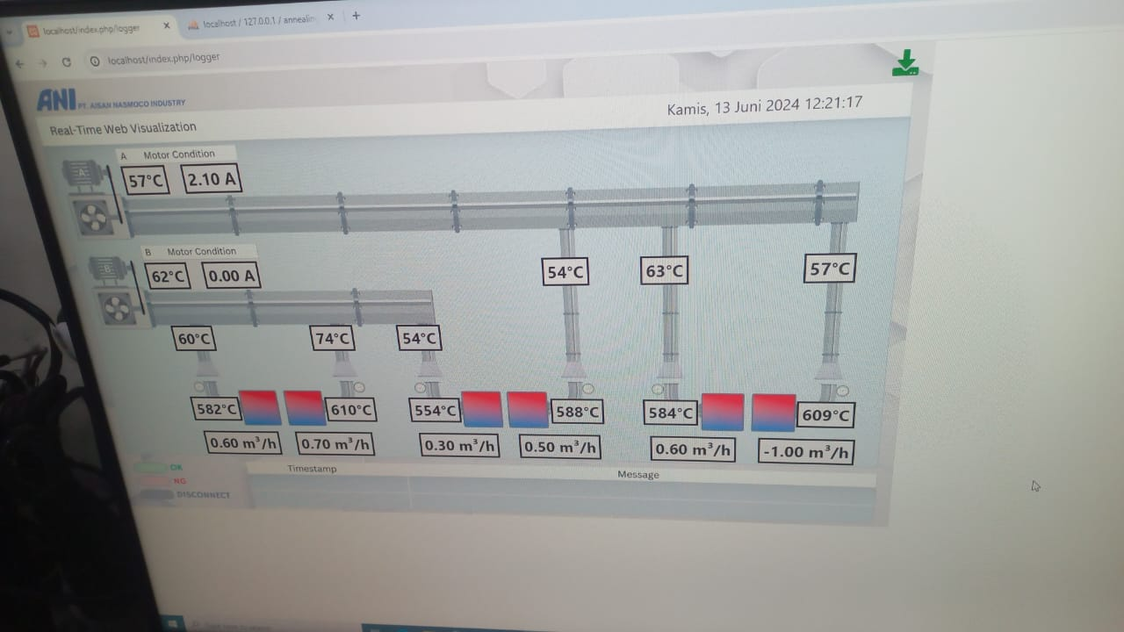
Server Display

Slide 5
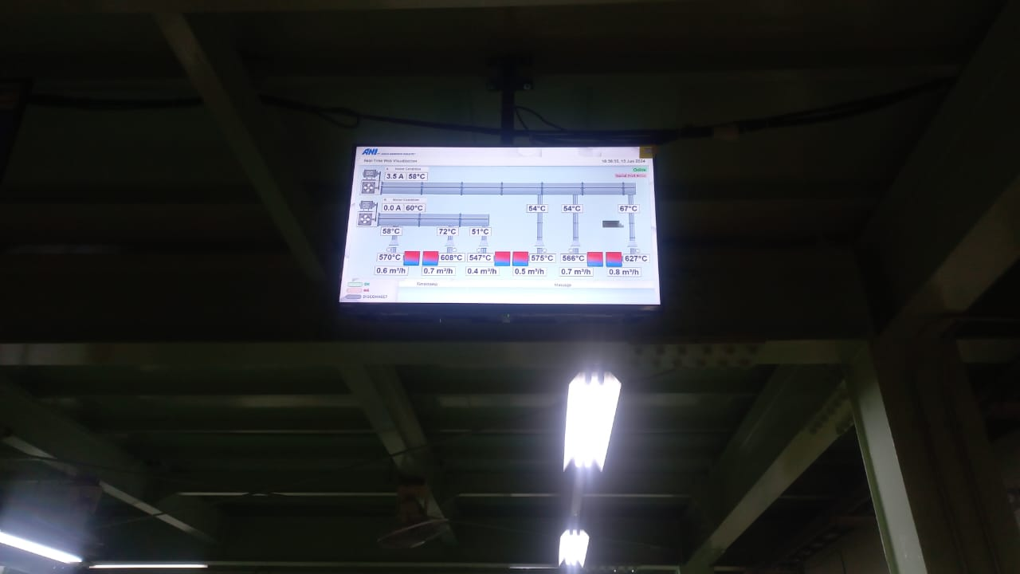
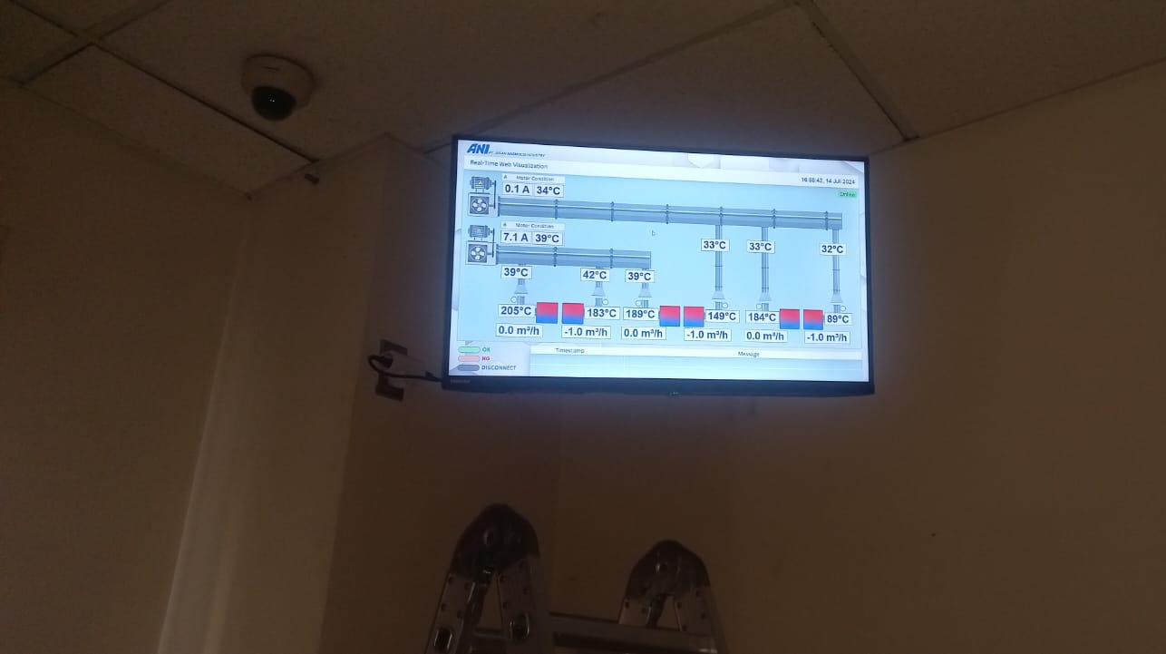
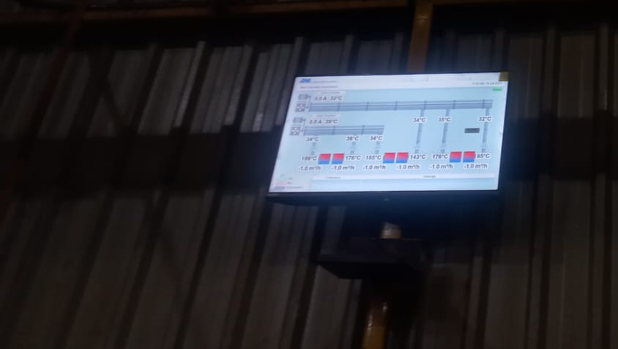
Real Time Monitoring Workshop
Real Time Monitoring Office
Real Time Monitoring Production Area

